Slide 1
Exploring Relationships In Air Quality and Hummingbird Species Distribution in California
Sierra Harris
Catherine Aznoe
Cristina Lefemine

Slide 2
Project Vision
Analyze and explore the relationship between changes in air quality and hummingbird distribution
Analyzing parameters within California for the purpose of this initial analysis project.
We hope our findings will contribute to the Scientific Community’s knowledge of the impacts poor air quality has on non-migratory and migratory bird species.
Ecological resilience is the inherent ability to absorb various disturbances and reorganize while undergoing state changes to maintain critical functions.

Slide 3
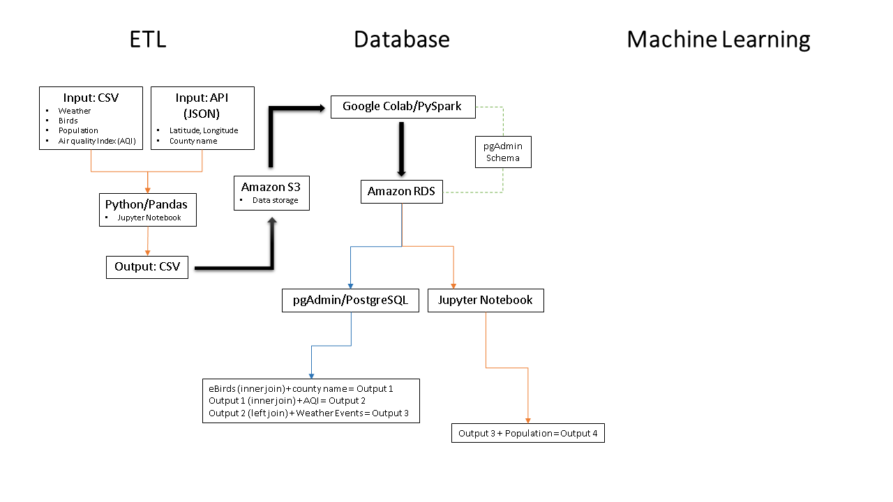
Notes:
Will transfer actual diagram, rather than copy of image, once diagram is complete.

Slide 4
Data Exploration
It all started with eBirds…
Wanted to know how/what would affect the bird species, that we eventually landed on
Wanted to look into environmental
Living in CA, and being subject to poor air quality, we chose to
Decided to focus on HB because they seem to be more susceptible to environmental factors

Slide 5
Database
Set up the database in AWS and used pgAdmin to edit tables.
Used PySpark in Google Colab to read in the cleaned data from AWS S3
Loaded the data into the database on AWS.
Further work in the database will be done using pgAdmin including the tables join based on location and date data.
Adding revisions soon…

Slide 6
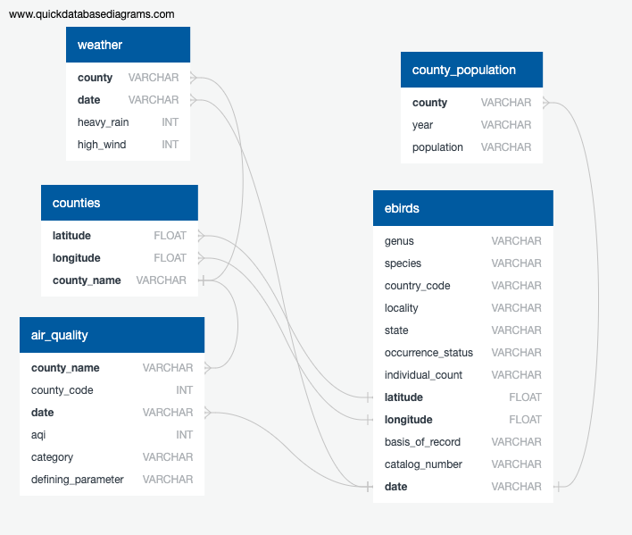

Slide 7
What features should be considered?
Air Quality
“Weather events”
High winds
Heavy rain
Notes:
“Variable” maybe should be referred to as “features”
Include “defining_parameter” (NO2, CO, Ozone, PM2.5, PM10)

Slide 8
Machine Learning
What models work best
What scores we got
Export the ML - HTML

Slide 9
Machine Learning
Description of preliminary data preprocessing:
Multiple data sets will be joined using postgres. Unnecessary features will be dropped. Missing data will be removed. Joining will be done along date and location. SQLAlchemy will allow for the data to be used for machine learning models.
Description of preliminary feature engineering and preliminary feature selection, including their decision-making process:
There will be a number of features from the ebird data and the Air quality data. The features vary but will all be relevant to prediction of bird observations.
Description of how data was split into training and testing sets:
Data will have the X value as the birds observed and the Y will be the remaining features. Testing and training will be performed using sklearn.model_selection.
Explanation of model choice, including limitations and benefits:
Different models have been set up to run the data that has been cleaned. Once Data is ready it will be pulled into the machine learning model and the accuracy scores will show which supervised model will work best. We decided on a supervised machine learning process because we want to classify our results.
Notes:
Include that we are doing supervised machine learning models because we are classifying the data and seeing the prediction of hummingbirds being present.
We’re not using SQLAlchemy to import data, just pandas sql.

Slide 10
Citations
Global Biodiversity Information Facility, Citation GBIF.org (10 October 2020) GBIF Occurrence Download https://doi.org/10.15468/dl.2rhbnh
Global Biodiversity Information Facility, Citation GBIF.org (10 October 2020) GBIF Occurrence Download https://doi.org/10.15468/dl.fsvwgj
Environmental Protection Agency, Daily Summaries, https://aqs.epa.gov/aqsweb/airdata/download_files.html#Daily
National Oceanic and Atmospheric Administration, Storm Events Database, https://www.ncdc.noaa.gov/stormevents/choosedates.jsp?statefips=6%2CCALIFORNIA#
Federal Communication Commission (FCC), Census Block for Developers, https://geo.fcc.gov/api/census/#!/block/get_block_find
California Association of Counties, Data and Research, https://www.counties.org/data-and-research

